Slide 1
Agorakube
Usability Test: Cognitive Walkthrough

Slide 2
Persona
Mikey J
New employee at a database driven company trying to create a node based logistical environment for the company to run separate projects.
Recently dual booted to Ubuntu with no prior experience.
Would not understand next actions very well
Needs very dense instruction set to run, showing various scenarios.

Slide 3
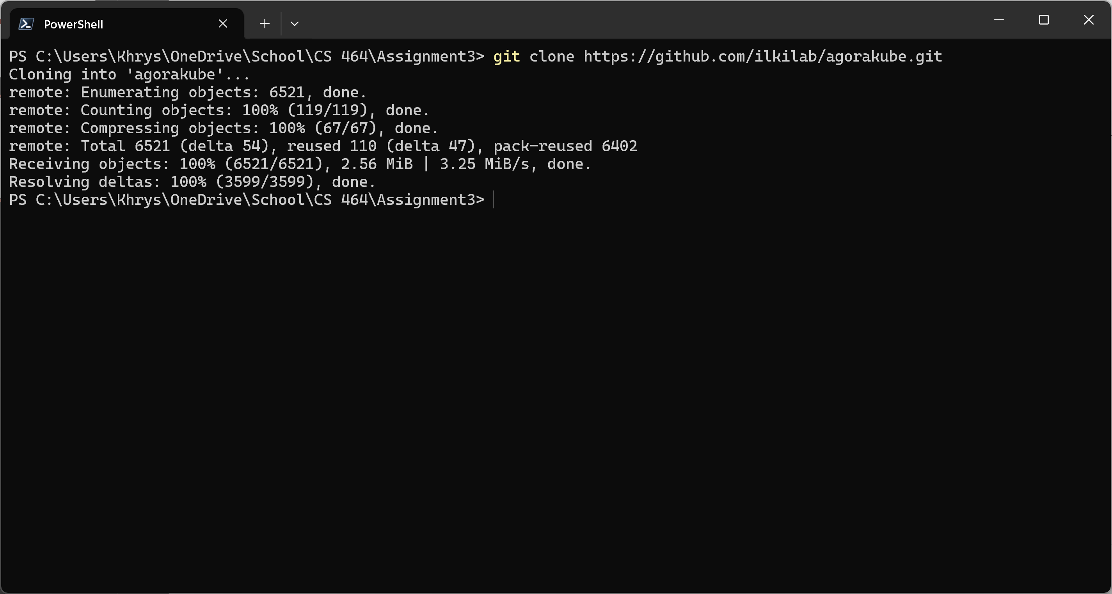
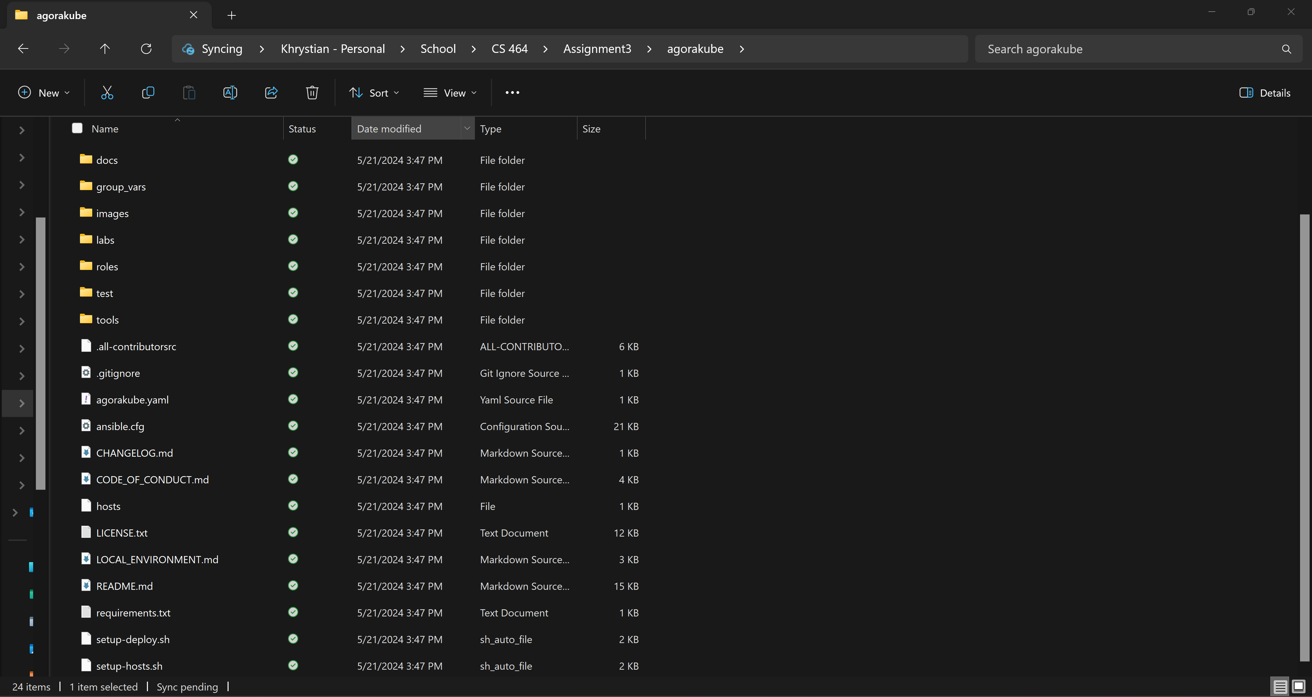
Preparation
Setup the environment
Clone the repository
Review documentation
Notes:
Commands: Check to ensure memory available. OS is up to date. Cloned the repo (Command in screenshot). Review documentation (reviewed to ensure it is was cloned without issues).
Notes: This portion of the process was very simple and easily laid out in the directions. Very easy to follow and clear on what the criteria for is.

Slide 4
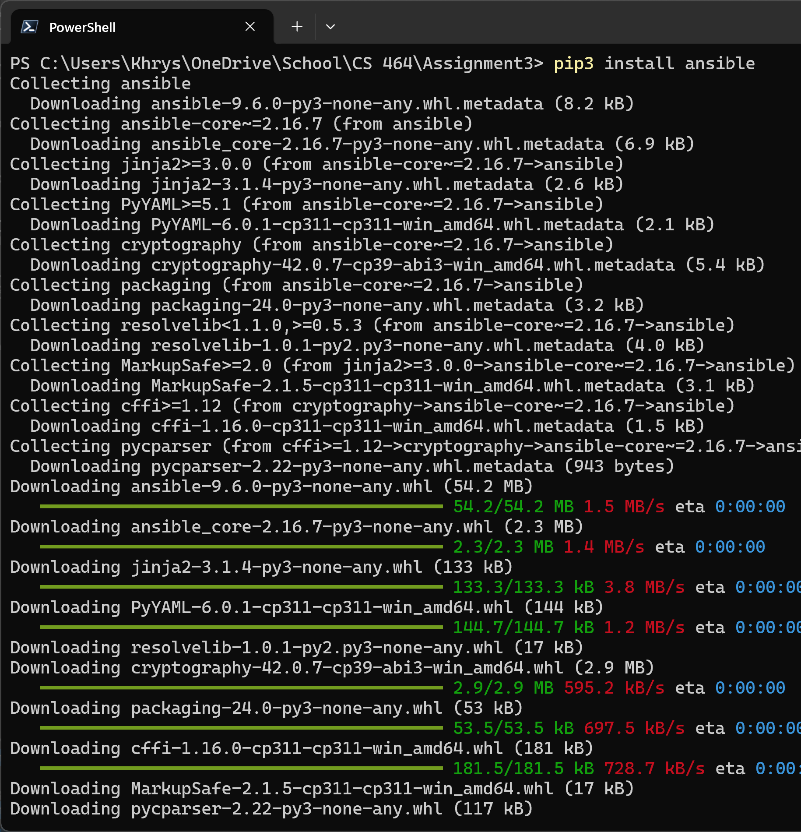
Installation
Commands:
# Create a Python Virtual Environment
python3 -m venv /usr/local/agorakube-env
# Tell to your shell to use this Python Virtual Environment
source /usr/local/agorakube-env/bin/activate
# Update PIP
pip3 install --upgrade pip
# Then install Ansible and Netaddr (needed by AGORAKUBE)
pip3 install ansible
pip3 install netaddr
pip3 install selinux
Unsuccessful due to virtual environment setup (see notes and findings)
rror on the screenshot to the left
Notes:
Commands: In the slide
Notes: This is the bread and butter of the testing. This portion was very thorough, in most cases too thorough. It seems that every possible outcome or scenario is and was addressed. The over flow of information in the installation instructions take away from them actually being instructions and turns the install process install a total overview of how to create and utilize the modes and Kubes. This reason led me to end my screen recording and move to a slideshow format, because it was taking me a long time to parse through just to simply test a project. The table of contents is helpful, but that is the first sign that there is far too much in this document. The setting up of the virtual environment directions were great and clear but the symantics of the commands led to walls that could be overcame if I were to adjust information, but as we are on a purely information seeking task for feedback, I did not make any changes or corrections.

